Slide 1
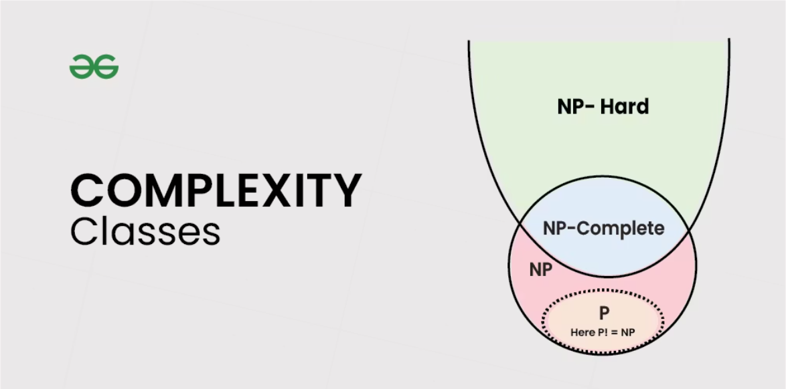
Complexity Classes, Problem and its types: Abstract, Decision, Optimization
Presented by: Manila Aryal

Slide 2
What Are Complexity Classes?
Complexity classes are a cornerstone of theoretical computer science, categorizing problems based on the resources required to solve them. Our primary focus will be on time complexity, which measures how the runtime of an algorithm grows with the size of its input.
Efficiency Matters
Problem Categorization
Key Classes
Distinguishes between problems solvable in polynomial time (efficient) and those requiring exponential time (often intractable).
Groups problems by their inherent difficulty, helping us understand the limits of computation.
P (efficiently solvable), NP (efficiently verifiable), and NP-Complete (the "hardest" in NP).

Slide 3

Class P: Efficiently Solvable Problems
Class P encompasses problems that can be solved by a deterministic algorithm in polynomial time. This means the time taken to solve the problem grows as a polynomial function of the input size (e.g., O(n), O(n²), O(n³)).
"Polynomial time problems are generally considered 'tractable' or 'efficiently solvable' in practical terms."
A classic example is sorting algorithms like Mergesort, which runs in O(n log n) time. These problems are fundamental to everyday computing, forming the basis of many practical applications where fast solutions are essential.

Slide 4

Class NP: Verifiable in Polynomial Time
Problems in Class NP (Non-deterministic Polynomial time) are those for which a given solution, if one exists, can be verified in polynomial time. This is a crucial distinction: finding the solution might be incredibly hard, but confirming its correctness is relatively easy.
Consider the Subset Sum problem: given a set of integers, does any non-empty subset sum to zero? Finding such a subset can be very difficult, but if someone hands you a subset, you can quickly add its numbers to check if they sum to zero.
It is widely accepted that P ⊆ NP, meaning every problem solvable in polynomial time is also verifiable in polynomial time.

Slide 5


NP-Complete: The Pinnacle of Difficulty in NP
NP-Complete problems are the "hardest" problems within NP. They possess two key properties:
Membership in NP
NP-Hardness
They must belong to the class NP, meaning their solutions can be verified in polynomial time.
Every other problem in NP can be transformed (reduced) into an NP-Complete problem in polynomial time. This implies that if you find a fast algorithm for one NP-Complete problem, you've effectively found a fast algorithm for ALL problems in NP.
The 3-SAT problem (Boolean satisfiability) is a famous example. The profound implication here is the P vs NP question: Is P = NP? This is one of the most significant unsolved problems in computer science, with a million-dollar prize attached.

Slide 6






What is a Computational Problem?
A computational problem defines a task or question that an algorithm aims to solve. Understanding the different types helps us classify and approach them systematically.
Decision Problems
Problems with a definitive Yes/No answer.
Abstract Problems
General definitions, theoretical concepts, often without specific inputs.
Optimization Problems
Seeking the "best" possible solution based on specific criteria.

Slide 7
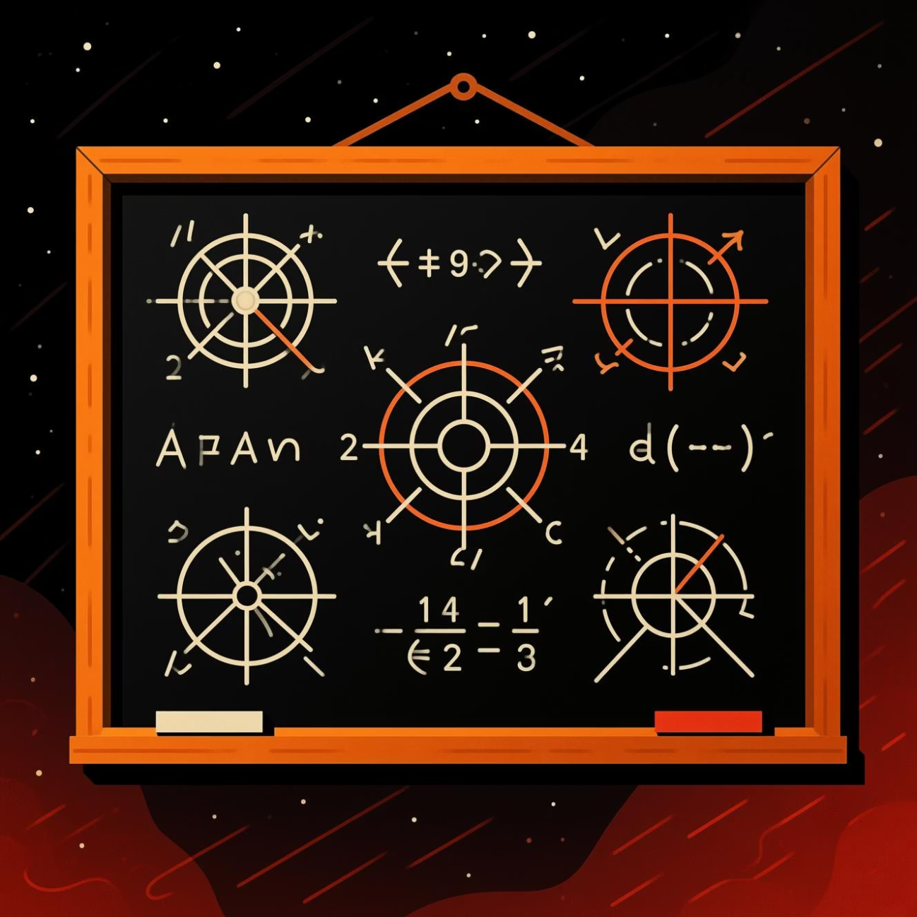
Abstract Problems: The Foundation
Abstract problems are stated in general, often theoretical terms, without referring to specific input data or instances. They define the core question or task at a high level.
"Abstract problems serve as the essential conceptual frameworks upon which concrete problem instances are built and analyzed."
For example, "Given any string, find if it contains a repeating pattern" is an abstract problem. It doesn't specify which string or which pattern. These generalized statements are crucial for formalizing problems in complexity theory and algorithm design, allowing us to discuss their inherent difficulty regardless of specific data.

Slide 8
Decision Problems: Yes or No?
Decision problems are characterized by their output: a simple "yes" or "no" answer. This binary nature makes them the primary focus of complexity theory, as they elegantly map to the concept of solvability.
Is a number prime?
Does a graph contain a cycle?
Is a string a palindrome?
Given an integer N, is N a prime number?
Given a string S, is S the same forwards and backwards?
Given a graph G, does G contain at least one cycle?
Many real-world problems, even seemingly complex ones, can be reformulated as decision problems for the purpose of analyzing their computational complexity.

Slide 9
Optimization Problems: Finding the Best
Optimization problems go beyond a simple yes/no. They seek to find the best possible solution among a set of feasible options, according to some predefined criteria (e.g., minimum cost, maximum value, shortest path).
Traveling Salesman Problem (TSP)
Knapsack Problem
Find the shortest possible route that visits a set of cities exactly once and returns to the origin city.
Given a set of items, each with a weight and a value, determine the number of each item to include in a collection so that the total weight is less than or equal to a given limit and the total value is as large as possible.
Optimization problems are often harder than their decision counterparts, though decision versions are frequently used to study their underlying complexity.

Slide 10
Conclusion
Understanding complexity classes and problem types is fundamental to modern computing:
01
02
03
Guides Algorithm Design
Foundation for Innovation
The P vs NP Challenge
Helps choose algorithms and recognize inherent intractability.
Drives research in cryptography, AI, and operations, where efficient solutions are paramount.
This open question continues to shape theoretical computer science, influencing our understanding of computability.
These concepts equip us to tackle challenging computational problems, driving technological progress and our understanding of what's computable.

